Slide 1

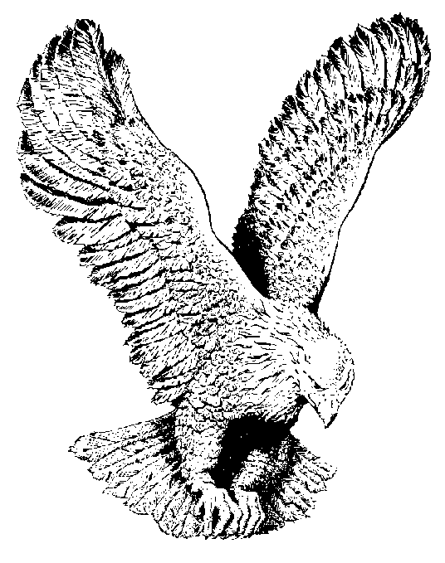
126
THE SHEEP OF HIS PASTURE
The sheep of His pasture have gathered
To hear what the Shepherd would say,
His voice like the sound of slow waters,
Came rippling through vessels of clay.

Slide 2
‘Tis the voice that brought forth creation
And set all the stars in array,
And speaks words of Life and of wisdom,
In the midst of His people today.

Slide 3
Through prophets, by precious blood purchased,
Cleansed and surrendered and filled.
And set in the Body for service,
As the Head of the Body hath willed.

